Slide 1
Active Shape Models
Suppose we have a statistical shape model
  Trained from sets of examples
How do we use it to interpret new images?
Use an “Active Shape Model”
Iterative method of matching model to image

Slide 2
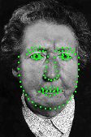
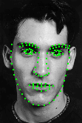
Building Models
Require labelled training images
  landmarks represent correspondences

Slide 3

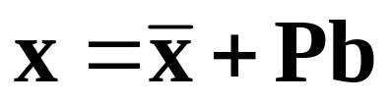
Building Shape Models
Given aligned shapes, { }
Apply PCA
P – First t eigenvectors of covar. matrix
b – Shape model parameters

Slide 4
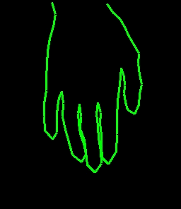
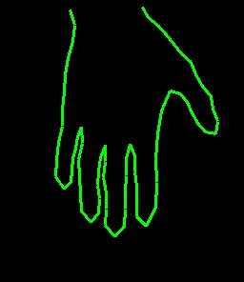
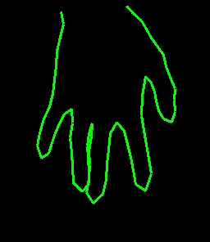
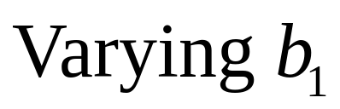
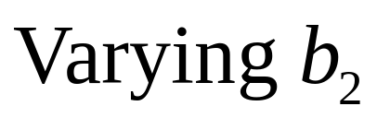
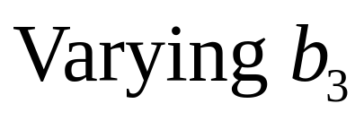
Hand Shape Model

Slide 5
Active Shape Models
Match shape model to new image
Require:
  Statistical shape model
  Model of image structure at each point
Model Point
Model of Profile

Slide 6



Placing model in image
The model points are defined in a model co-ordinate frame
Must apply global transformation,T, to place in image
Model Frame
Image

Slide 7
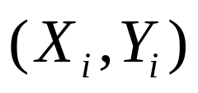
ASM Search Overview
Local optimisation
Initialise near target
  Search along profiles for best match,X’
  Update parameters to match to X’.

Slide 8
Local Structure Models
Need to search for local match for each point
Model
  Strongest edge
  Correlation
  Statistical model of profile

Slide 9




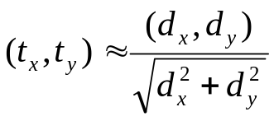
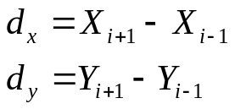
Computing Normal to Boundary
Tangent
Normal
(Unit vector)

Slide 10
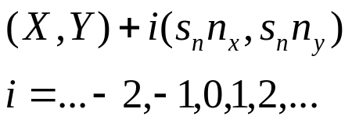





Sampling along profiles
Profile normal to boundary
Model boundary
Interpolate at these points
Model point

Slide 11




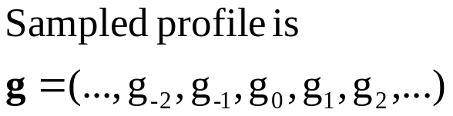
Noise reduction
In noisy images, average orthogonal to profile
  Improves signal-to-noise along profile

Slide 12

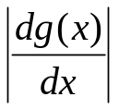

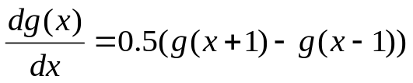
Searching for strong edges
Select point along profile at strongest edge

Slide 13
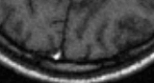
Profile Models
Sometimes true point not on strongest edge
Model local structure to help locate the point
Strongest edge
True position

Slide 14

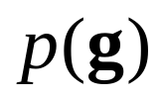
Statistical Profile Models
Estimate p.d.f. for sample on profile
Normalise to allow for global lighting variations
From training set learn

Slide 15
Profile Models
For each point in model
  For each training image
    Sample values along profile
    Normalise
  Build statistical model
    eg Gaussian PDF using eigen-model approach

Slide 16


Searching Along Profiles
During search we look along a normal for the best match for each profile
Form vector from samples
about x

Slide 17
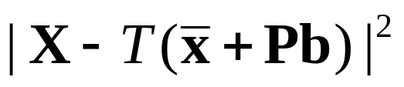
Search algorithm
Search along profile
Update global transformation, T, and parameters, b, to minimise

Slide 18
Updating parameters
Find pose and model parameters to minimise
Either
  Put into general optimiser
  Use two stage iterative approach

Slide 19

Updating Parameters
Repeat until convergence:
Analytic solution exists (see notes)

Slide 20
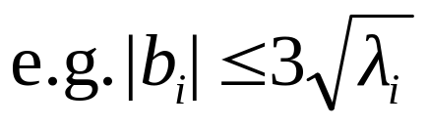
Update step
Hard constraints
Soft constraints
Can also weight by quality of local match

Slide 21
Multi-Resolution Search
Train models at each level of pyramid
  Gaussian pyramid with step size 2
  Use same points but different local models
Start search at coarse resolution
  Refine at finer resolution

Slide 22
Gaussian Pyramids
To generate image at level L
  Smooth image at level L-1 with gaussian filter (eg (1 5 8 5 1)/20)
  Sub-sample every other pixel
Each level half the size of the one below

Slide 23
Multi-Resolution Search
Start at coarse resolution
For each resolution
  Search along profiles for best matches
  Update parameters to fit matches
  (Apply constraints to parameters)
  Until converge at this resolution

Slide 24
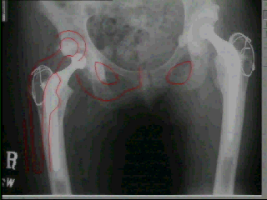
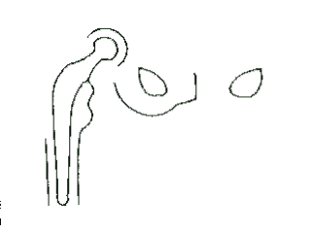
ASM Example : Hip Radiograph

Slide 25
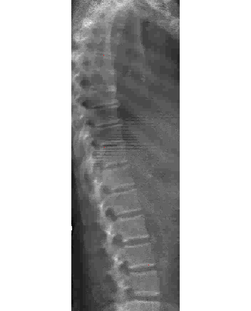
ASM Example: Spine

Slide 26
Active Shape Models
Advantages
  Fast, simple, accurate
  Efficient to extend to 3D
Disadvantages
  Only sparse use of image information
  Treat local models as independent

